Slide 1

Flash Card Creator
COMP1004

Slide 2
Background and Vision
Creating a simple flash card editor and creator
Easily access and store ones you’ve created
Many existing sites for this have a lot of unnecessary thing on them
Many require logins and creating accounts

Slide 3
Sprints carried out
Sprint 1: Jan1 – Jan 14
Created GitHub Repo
Created simple homepage using HTML
Styled with CSS; JS to create overlay

Slide 4
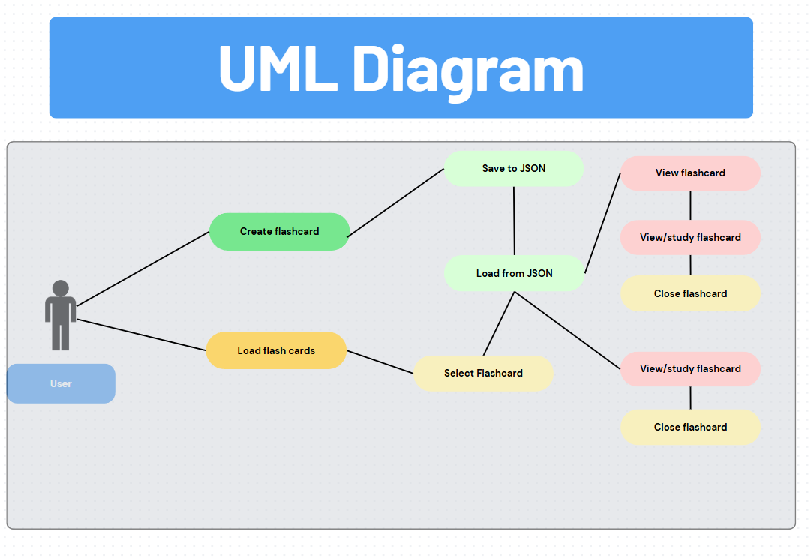
UML Design
Here is a basic UML image of my webpage
Give the rough outlines on how the application runs
Notes:
https://www.canva.com/design/DAGcCFgAJFg/5DqWVOXdJAUPh-fmUFRSzg/edit?referrer=uml-diagrams-landing-page

Slide 5
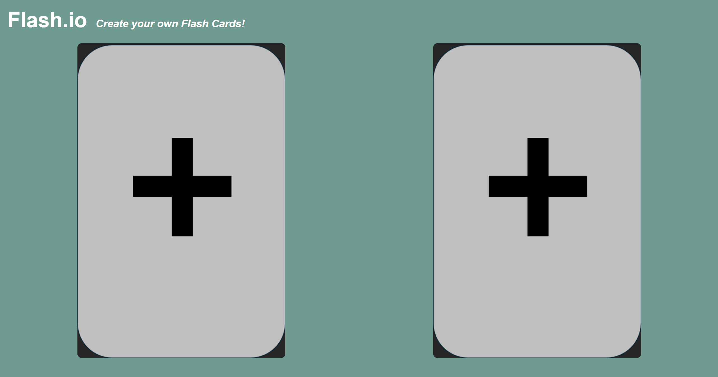
Prototype

Slide 6
Issues/Challenges Faced
Main challenge was it only being single paged which made it difficult to figure out how to display other content with out opening a extra page.
The JSON files could face storage limitations depending on how many flash cards the user creates, which could cause the application to slow down.

